Slide 1
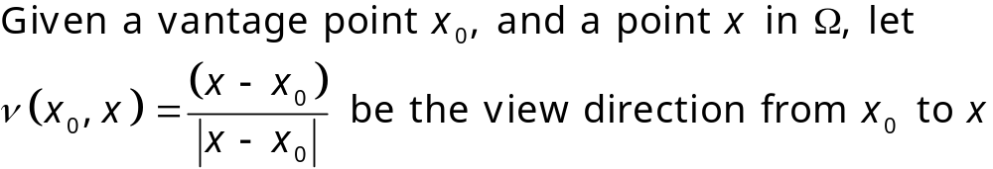
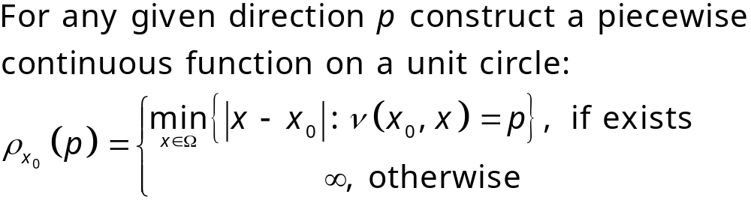
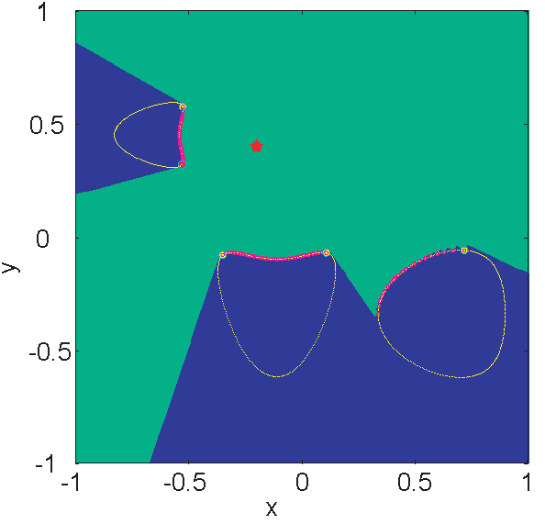
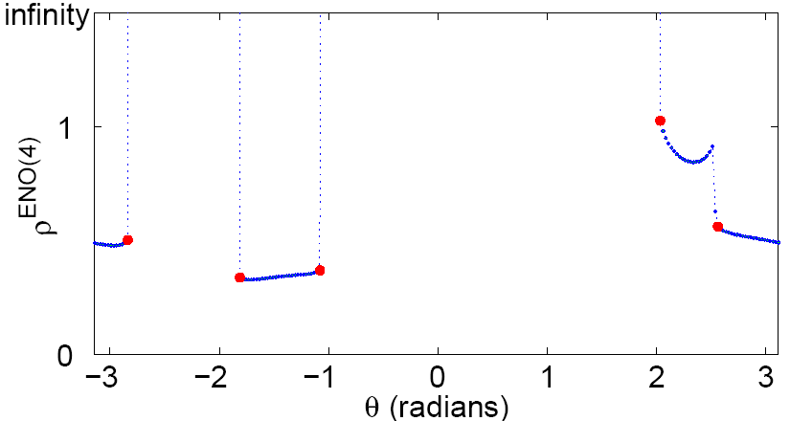

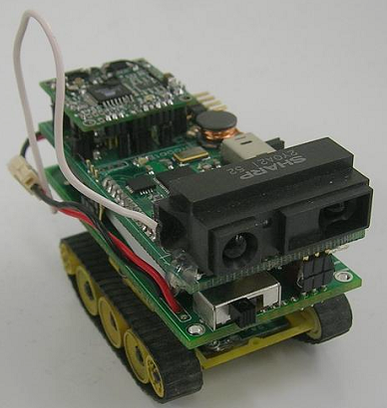
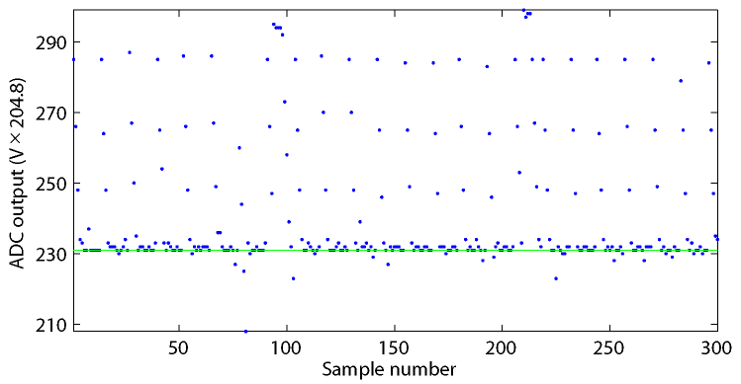
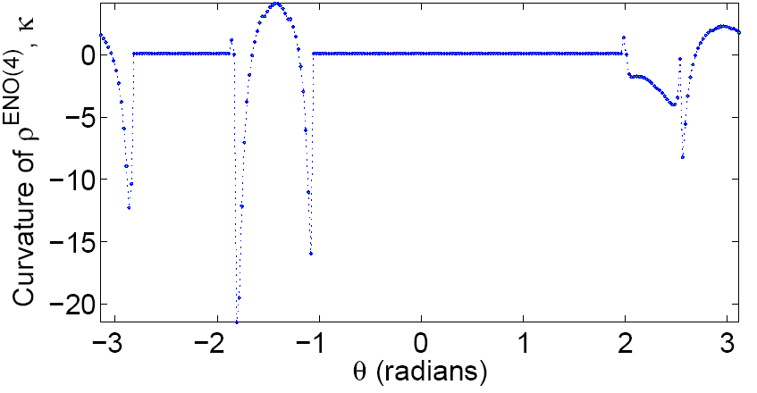
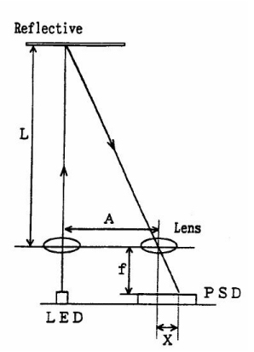
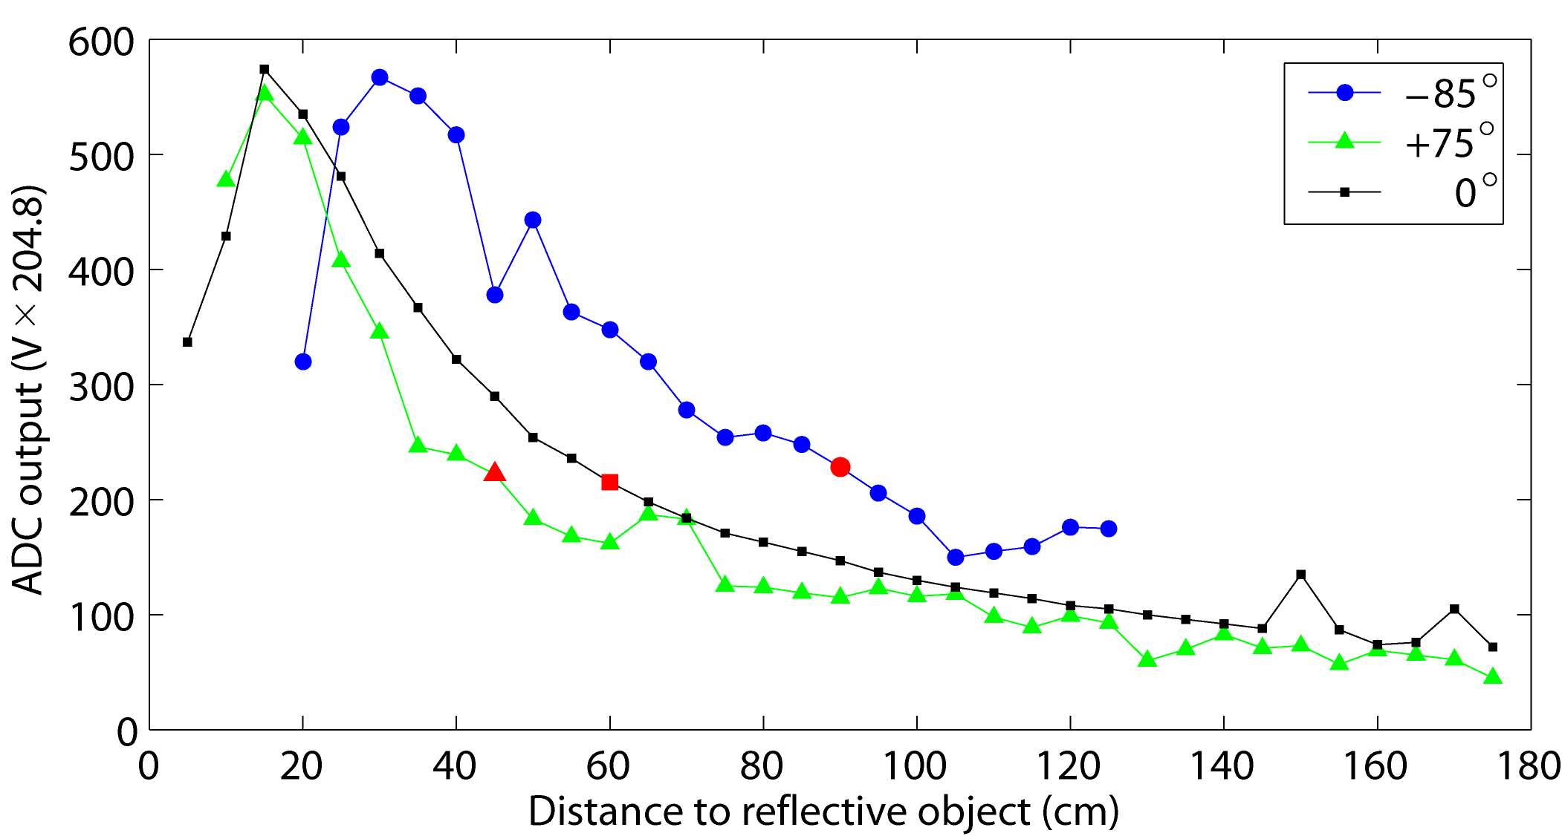
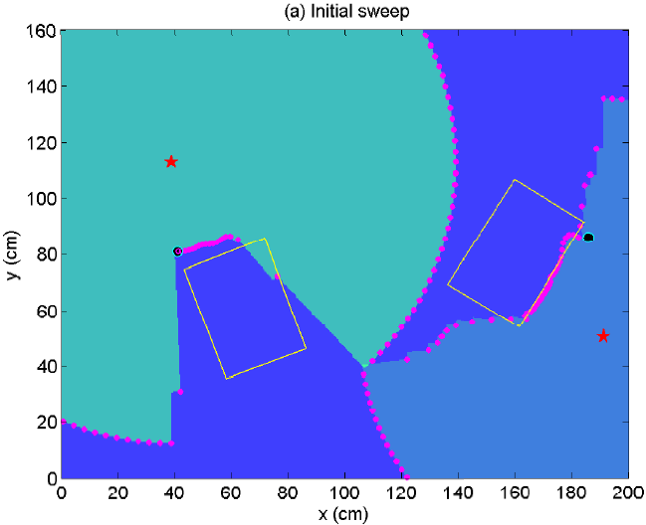
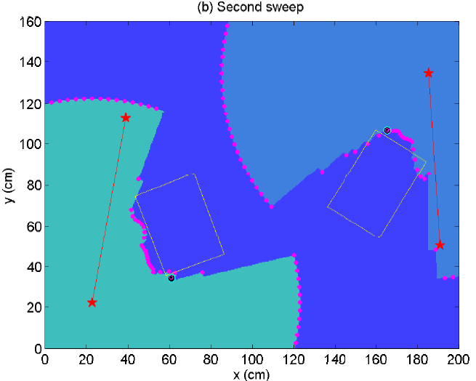
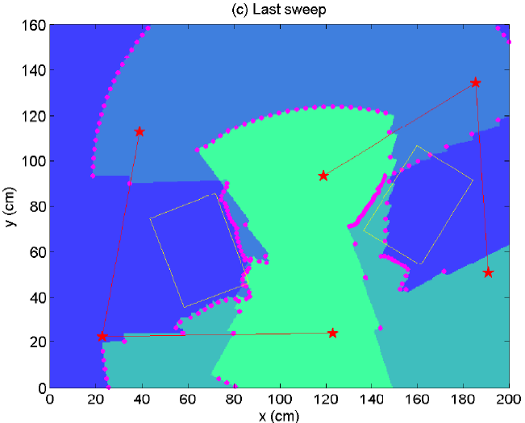
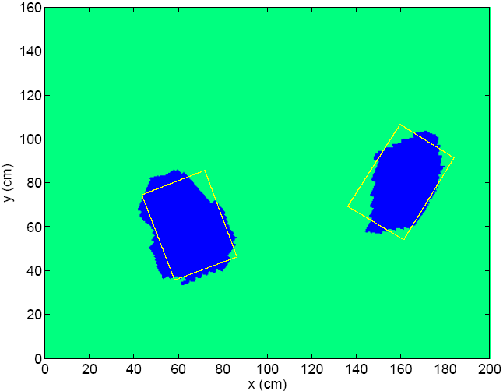
Robotic Path Planning and Visibility with Limited Sensor Data
Yanina Landa¹, David Galkowski², Yuan R. Huang³, Abhijeet Joshi³, Christine Lee⁴, Kevin K. Leung³,
Gitendra Malla⁵, Jennifer Treanor⁶, Vlad Voroninski⁷, Andrea L. Bertozzi¹, and Yen-Hsi R. Tsai⁸
¹Dept. of Mathematics, University of California Los Angeles, ²Dept. of Physics, Harvard University, ³Dept. of Electrical Engineering, University of California Los Angeles, ⁴Dept. of Mathematics, California Institute of Technology, ⁵Dept. of Computer Science, Gettysburg College, ⁶Dept. of Physics, Trinity College Dublin, ⁷Dept. of Computer Science, University of California Los Angeles, ⁸Dept. of Mathematics, University of Texas at Austin
Visibility Interpolation [Landa, Tsai, Cheng, 2006]
1.
2.
3. Use Essentially Non-Oscillatory (ENO) interpolation [Harten et al. 1987] to reconstruct piecewise p^{th} order polynomial approximation to ρ
Visibility Interpolation on Artificial Data
Navigation Problem
Test-bed and Sensors
Goal: to explore an unknown bounded region and construct the map of the explored environment.
Restrictions:
Path continuous and consists of discrete steps,
Finite number of steps,
Total distance traveled is finite.
Algorithm summary:
Single Observer
From given x₀ construct visibility function ρ,
Find discontinuities in ρ (correspond to horizons, i.e. points where outer normal to the occluding surface),
Approach one of the discontinuities*,
Overshoot by amount proportional to the inverse of the curvature near the horizon,
Go to 1 or finish if have seen all the horizons.
* In this experiment we chose the rightmost horizon due to specifics of sensor output.
Multiple Observers
Same as for a single observer except do not consider the horizons visible by another observer.
Purpose: to study cooperative control strategies
Platform dimensions: 200x160 cm
Vehicles:
  Tank-based with caterpillar-style drive
  to allow small turning radius
  On-board processing and range sensing
  Communicate at 30 Hz
  Dimensions: 7x3.8x4.6 cm
  Weight: 65 g
Sensors:
  Manufactured by Sharp, model 2YOAO2 F58
  Range: 20-150 cm
  Wavelength range: 850 70 nm
Tank with the sensor
Raw sensor output
Sensor Layout
Sensor output at
different angles
Experimental Results with Two Vehicles
Map resulting from exploration
This research was supported as part of the Research in Industrial Projects for Students (RIPS) program at the IPAM, and funded by NSF grant DMS-0439872 and NSA grant H98230-06-1-0057. We would like to thank Matthew Sottile who was a RIPS industrial mentor from LANL. Additionally, this research was supported by NSF grant DMS-0601395, ARO MURI grant 50363-MAMUR, ONR grant N000140610059, ARO grant W911NF-05-1-0112, and NSF grant DMS-0513394.

